Slide 1
Congratulations for your decision to be healthy
WELCOME TO THIS HEALTHY COMMUNITY

Slide 2
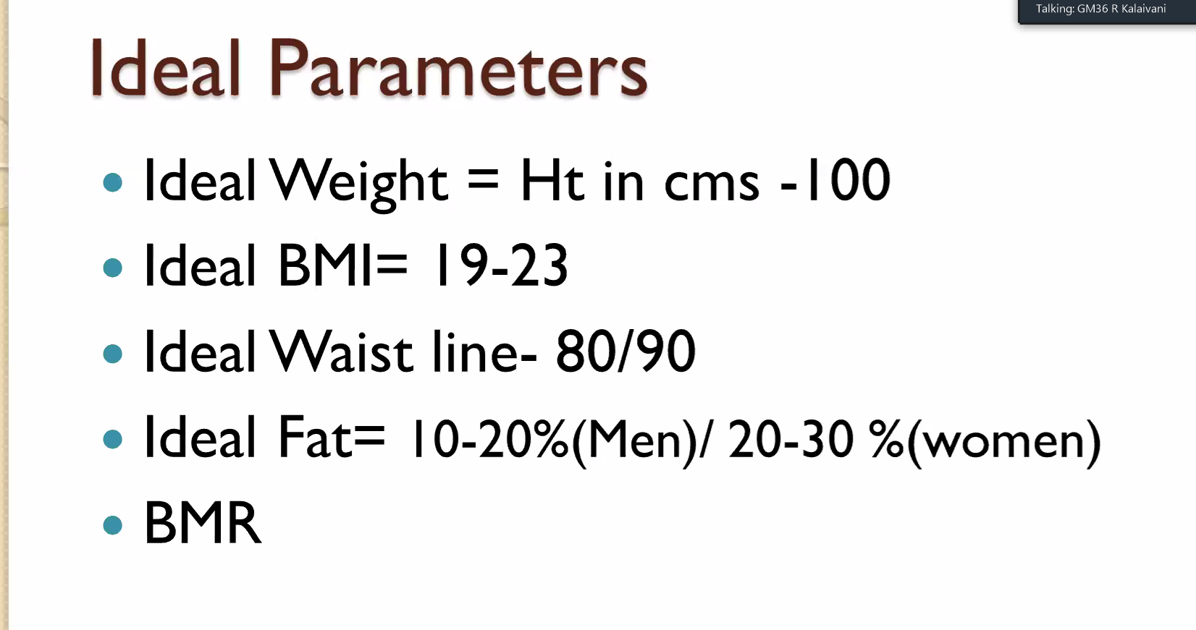

Slide 3
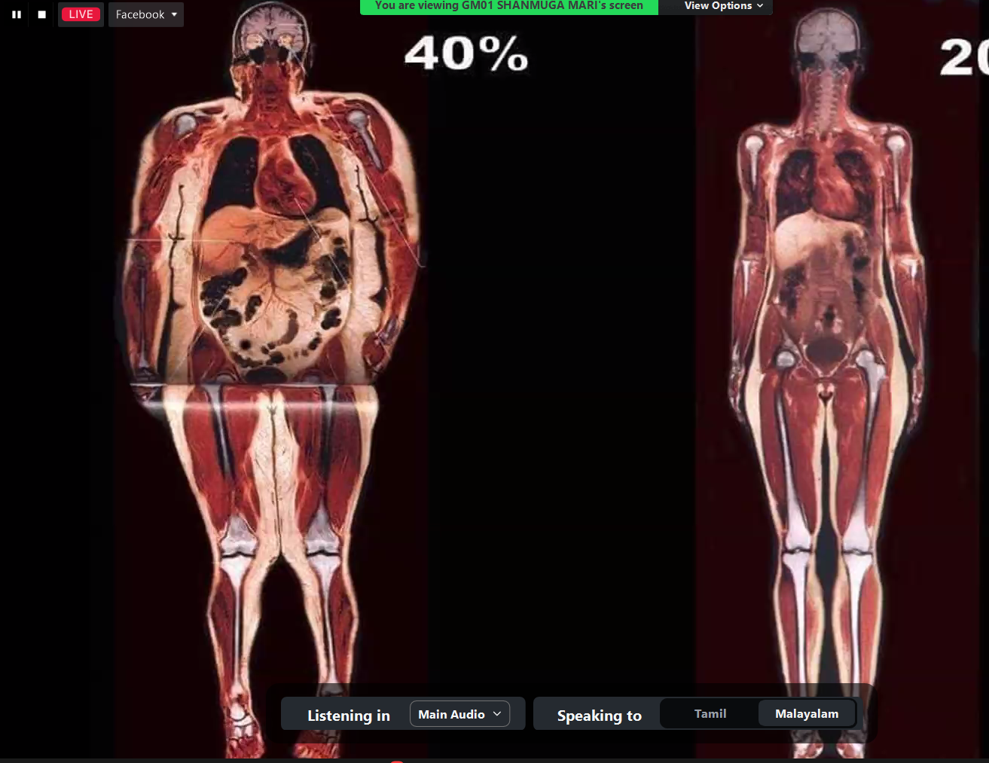

Slide 4
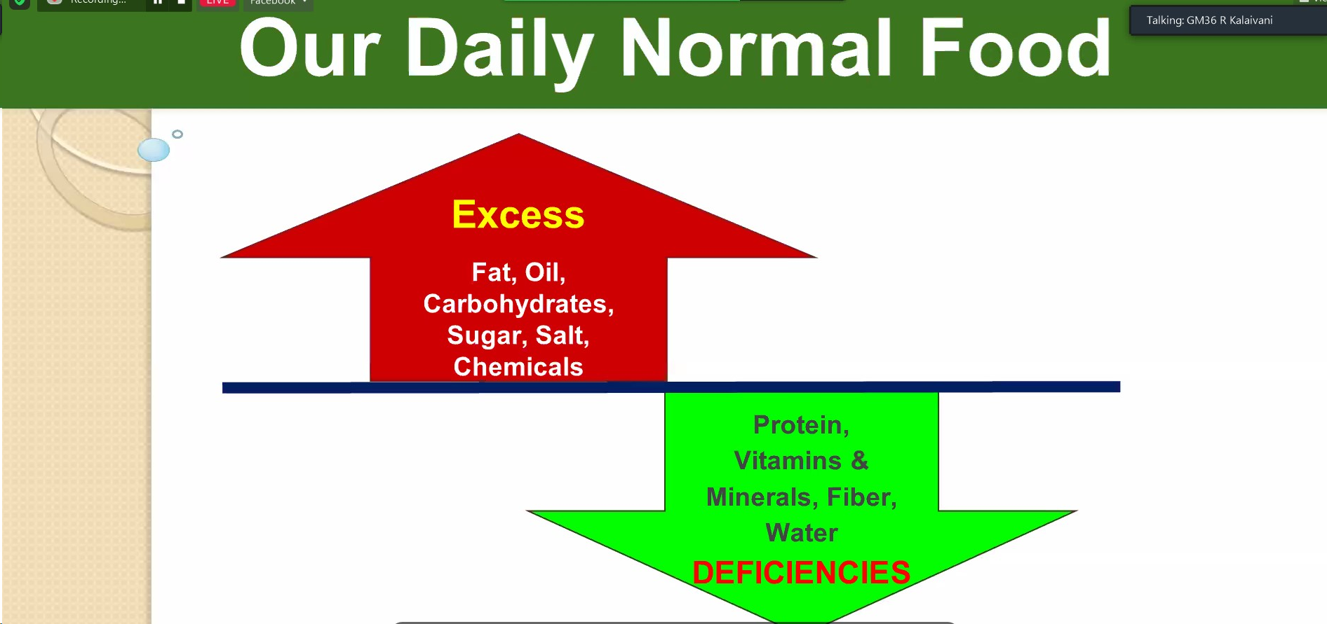

Slide 5
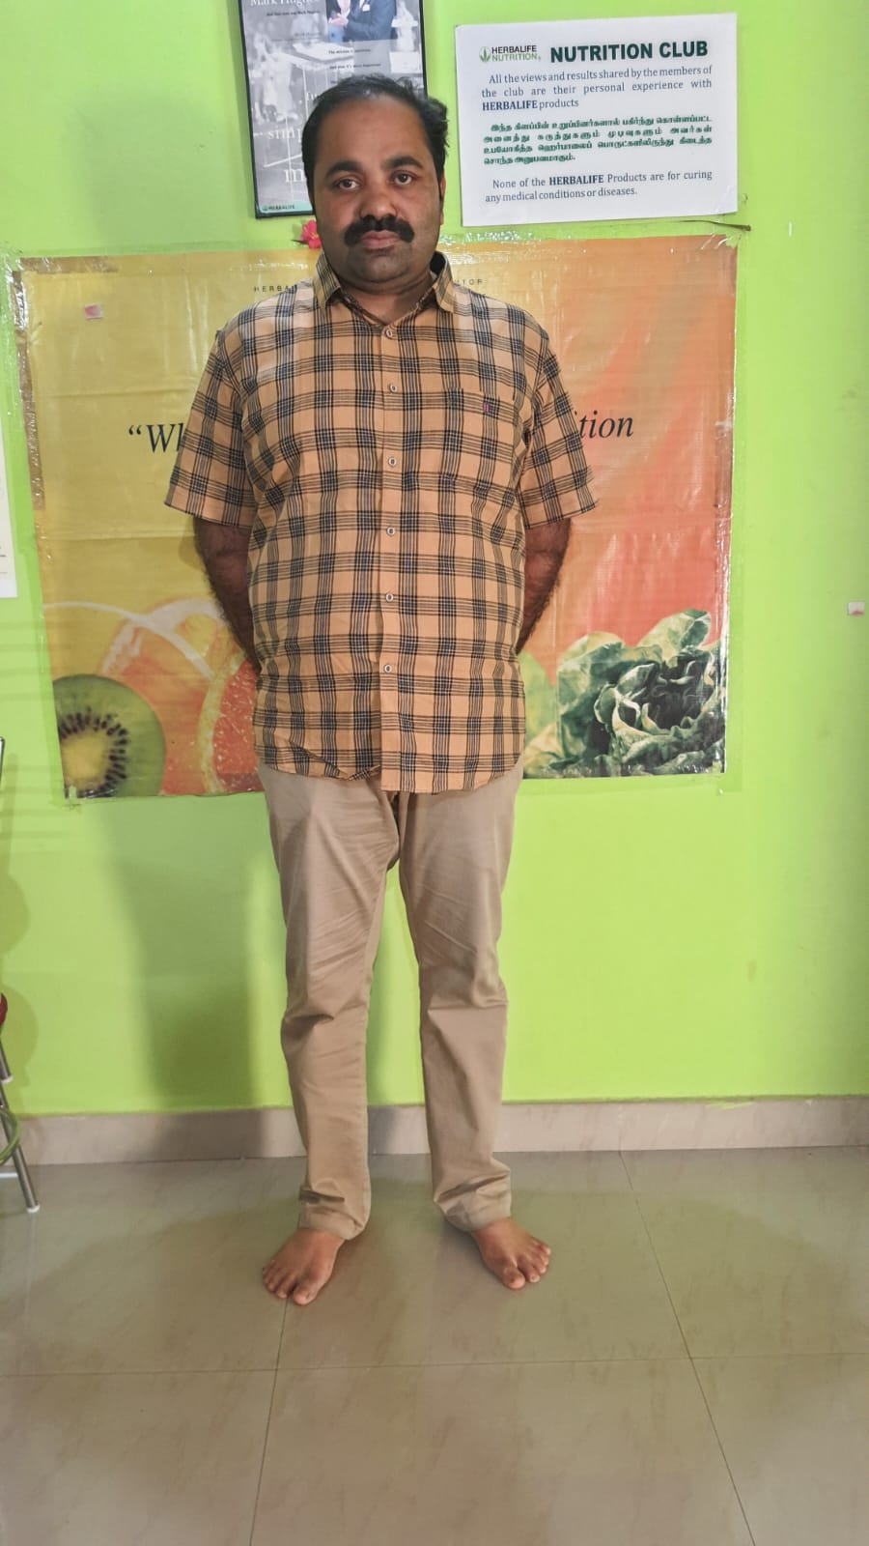
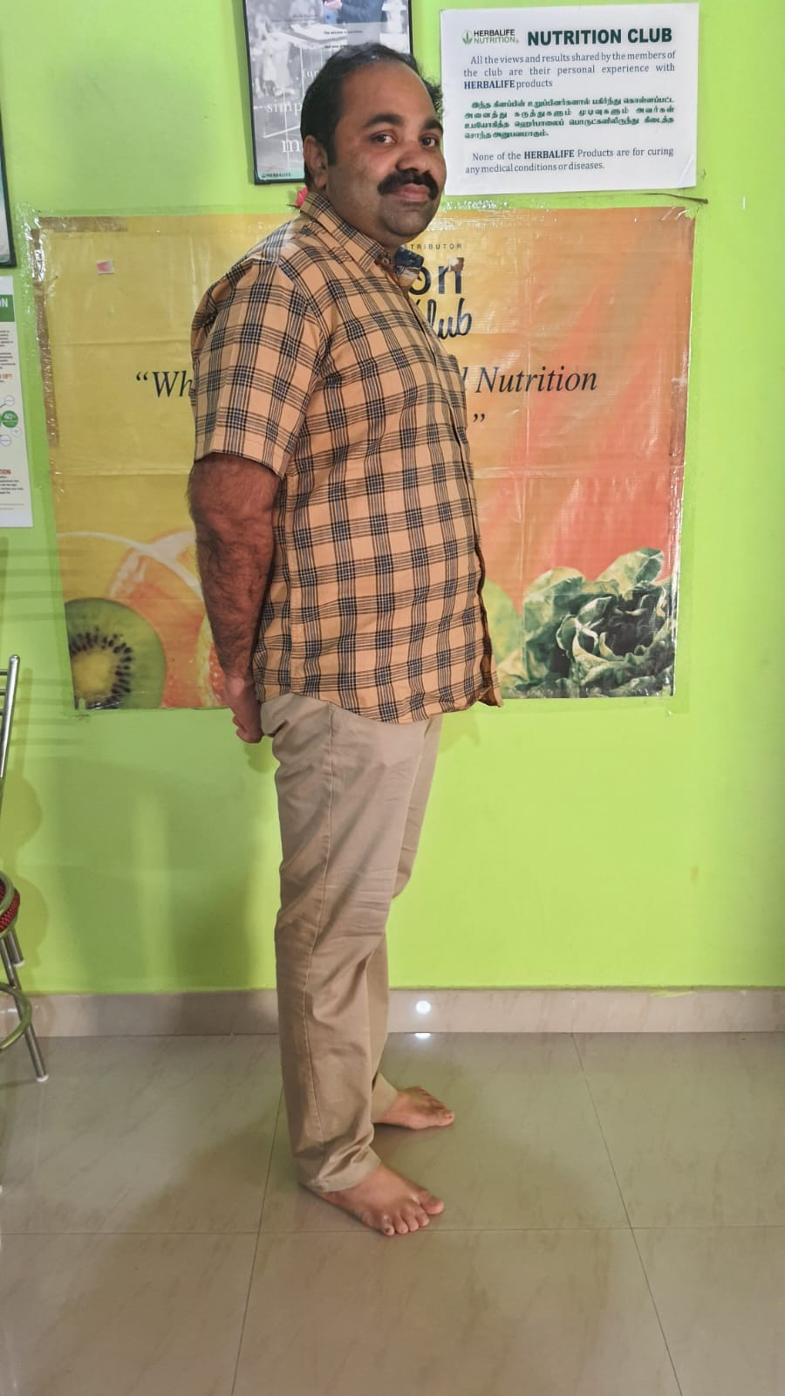
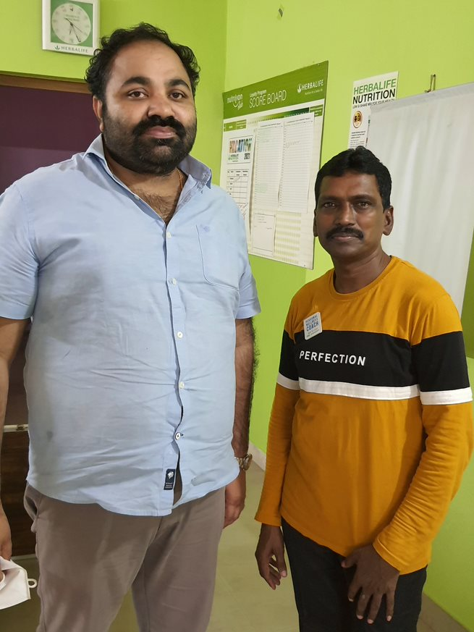

Slide 6
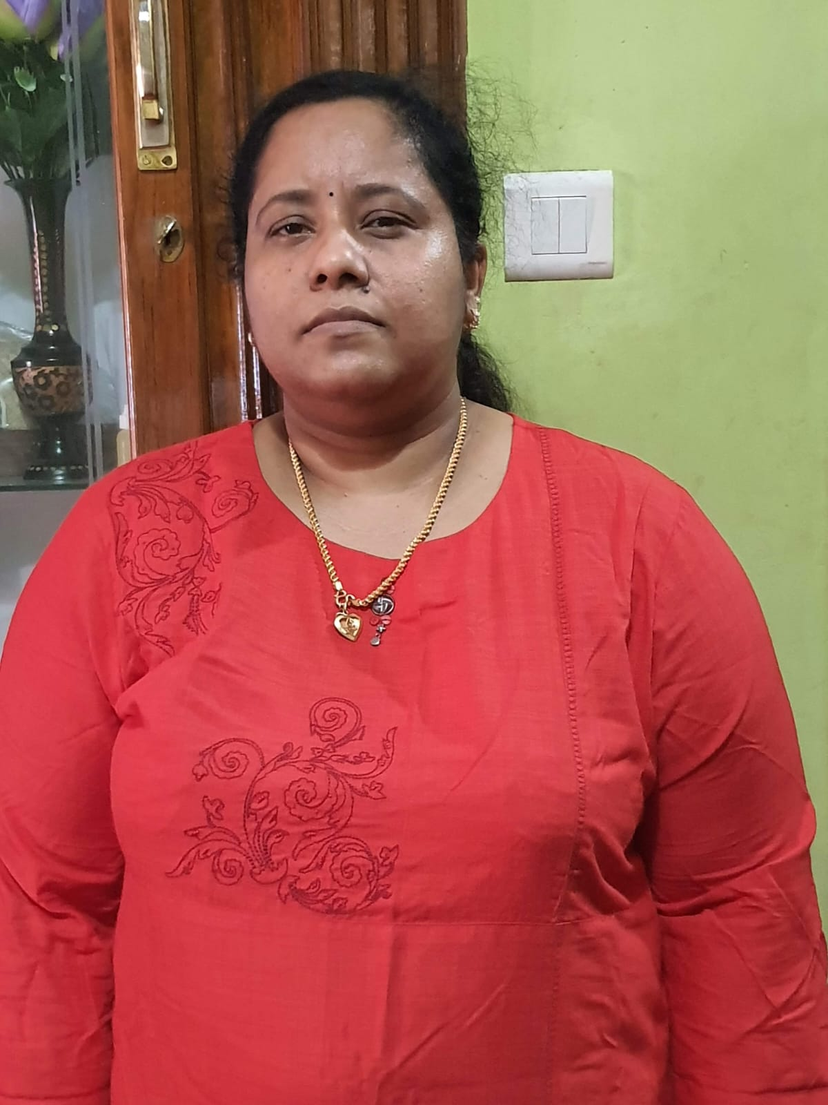
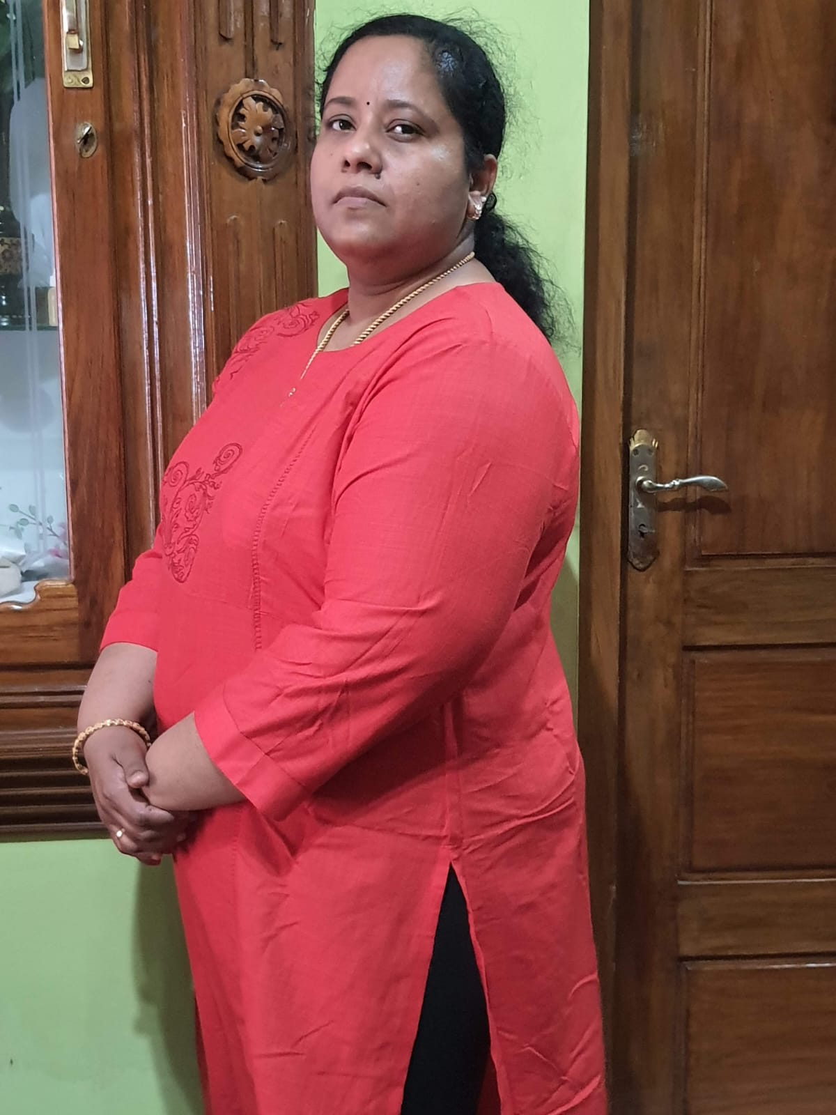
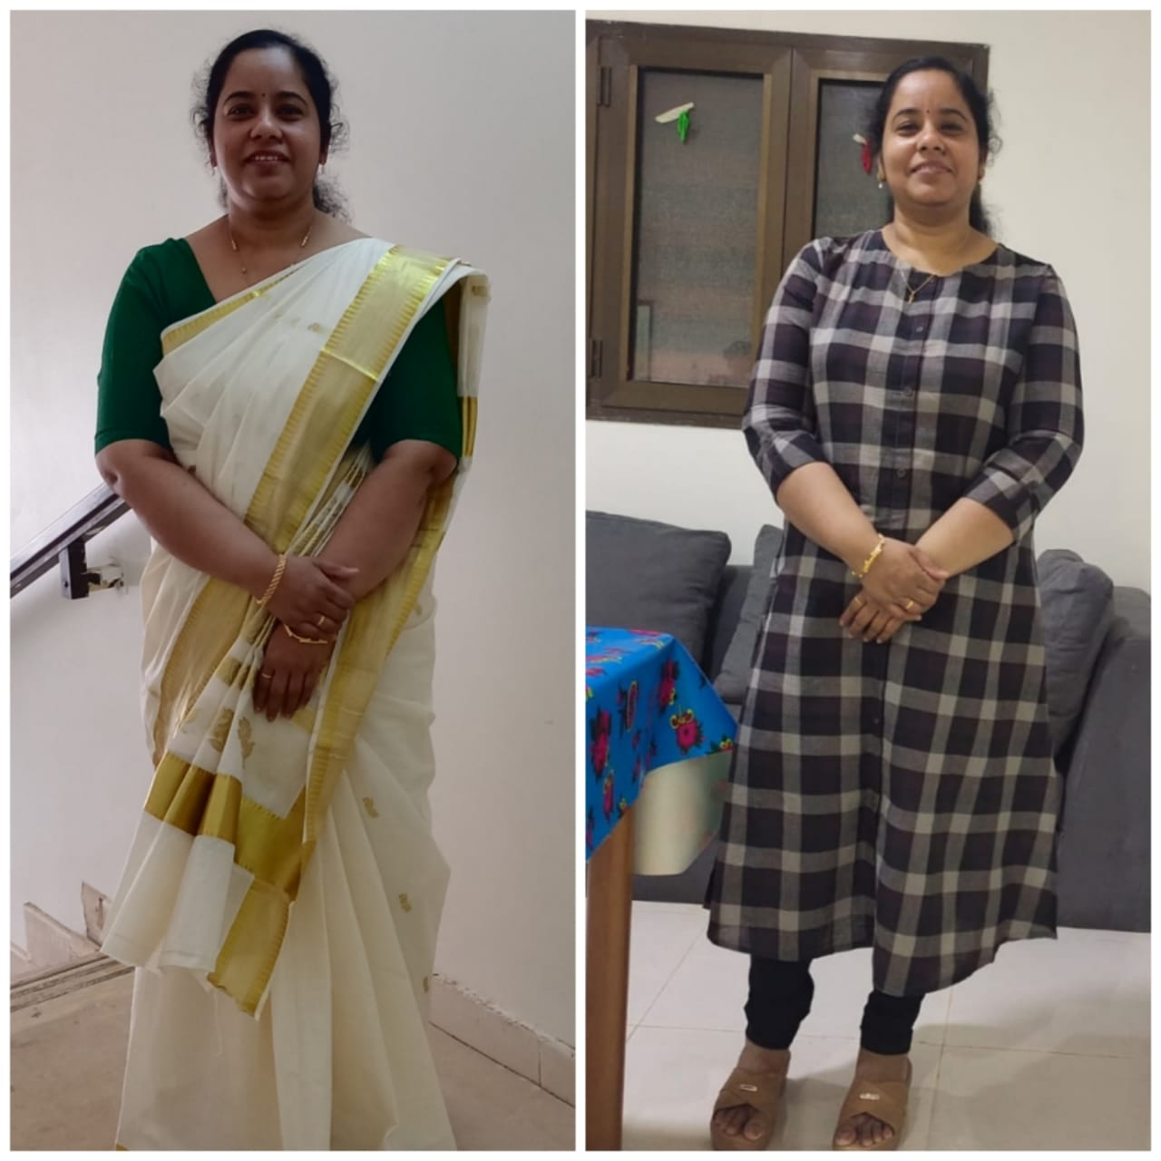

Slide 7
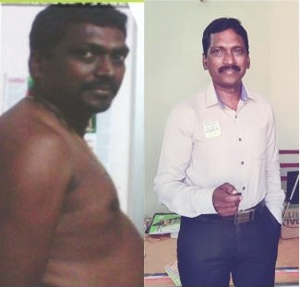

Slide 8
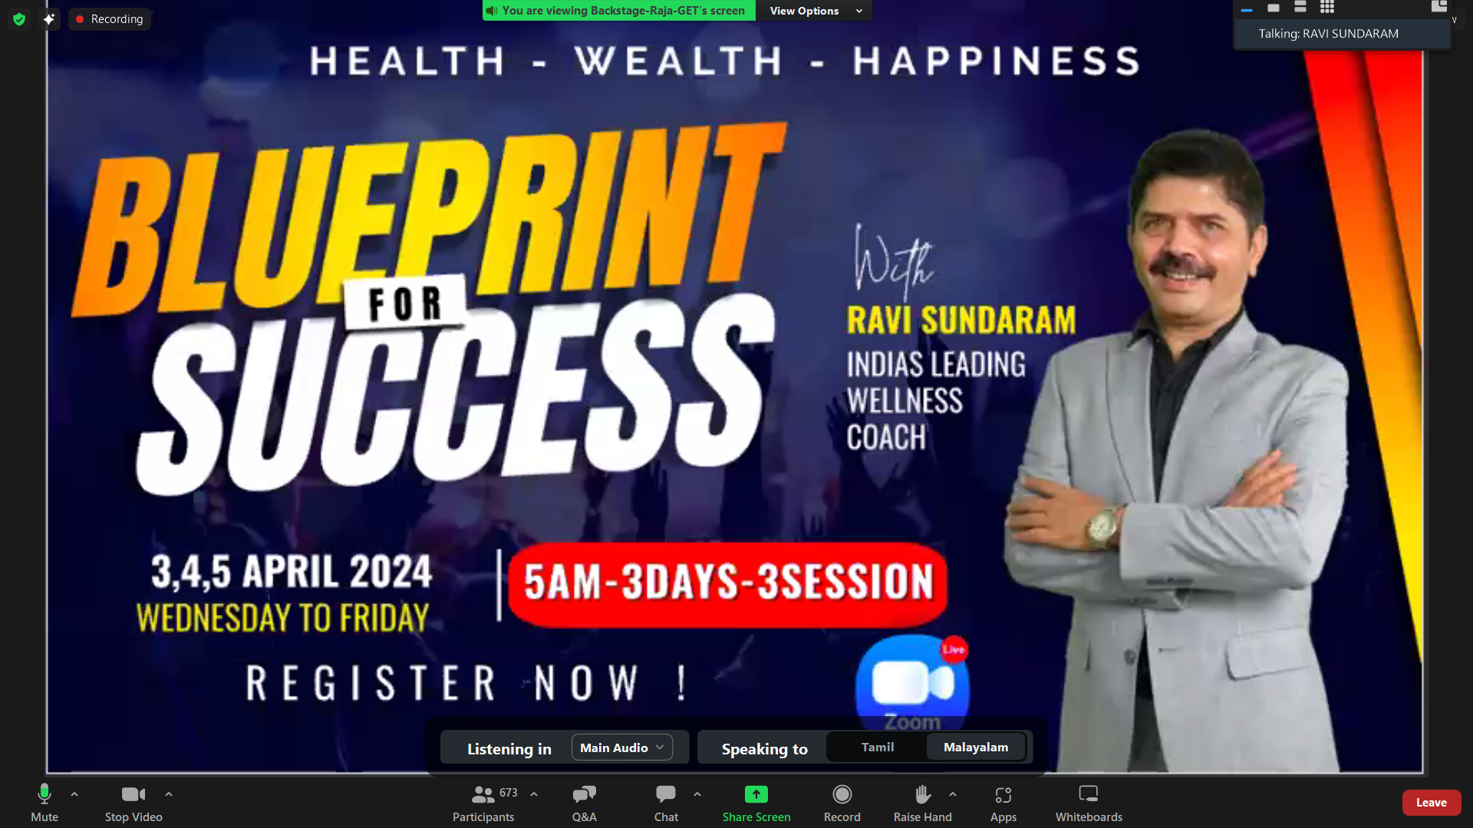

Slide 10


Slide 11
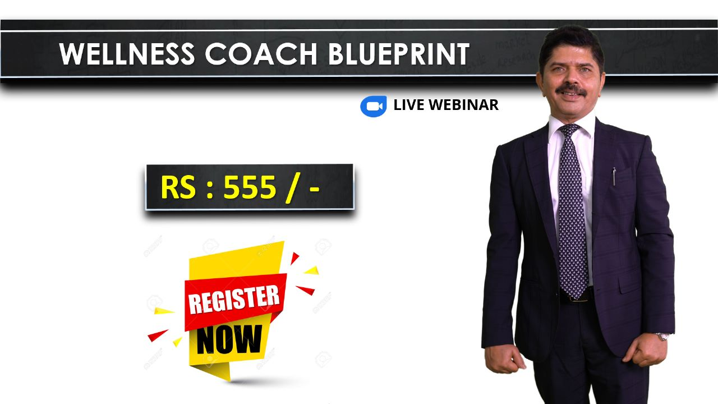

Slide 19


Start Your Journey
ONE MONTH PROGRAM
30 Days Personal Coaching
30 Days Session & Education Link
30 Days HALA Link
Healthy Meal Preparation Class
Body Transformation Challenge
Blueprint For Success Link 1
India No.1 Coach Seminar Link For 2 Person
Family Trial Pack
Rs. 9369

